Slide 1
Jasmine Tapia
LHS Class of 2013

Slide 2
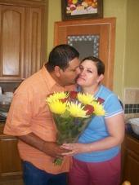
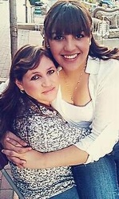
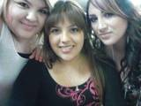
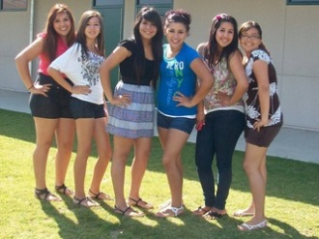
About me
The future belongs to those who believe in the beauty of their dreams.
-Eleanor Roosevelt
Family of 6 I'm the second youngest
- Born and raised in Lindsay CA
My interests
- Music, dancing, sinning, cooking and
hanging out with friends
Activities I have been involved in:
-M.E.C.H.A Club
-Color Guard Club
-Soccer Team

Slide 3
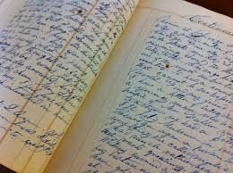
Senior Writings
Senior Projects
Journals
Visual Representation
Autobiography
Research Paper
Job Shadow
Most Meaningful:
Job Shadow

Slide 4
Journals
Most Meaningful:
Journal #1 and #8
My biggest challenges I faced these four years:
Getting use to the grading system
Getting back on track after falling behind in
many of my classes
Greatest accomplishment
Finishing my A-G classes I needed
What I have learned
High is no joke, needs to be taken serious especially
senior year
Future Plans
Attend community collage then transfer and go into the field of education

Slide 5
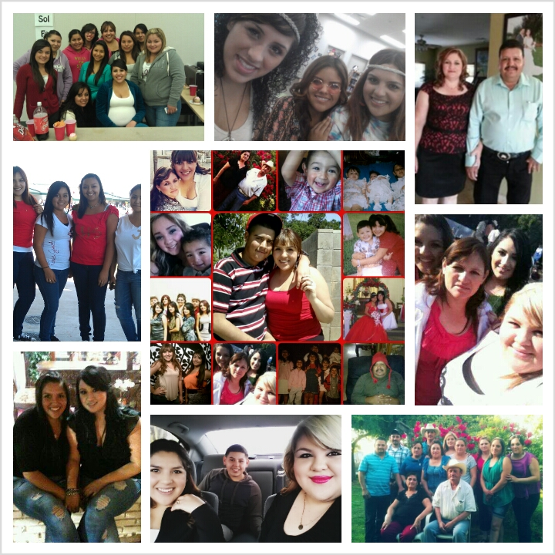
Visual Representation
Life
Family
Friends
Thankful
Meaningful
Complete me
Loved by each
Made me who I am
Always there for me
Couldn’t ask fro more
Huge impact in my life
Each is very important to me

Slide 6
Research Paper
Virginia Tech Shootings
April 16, 2007
First shooting occurred around 7:15am while
students were on their way to class
Two girls were killed in the first shooting
Second shooting occurred around 10:15am
33 people killed and many injured

Slide 7
Job Shadow
Teacher
Day October 29, 2012 I really enjoyed observing
Mrs. Lemus everything she did. I loved the
Fourth Grade Teacher way she taught. I look forward
Works at Reagan to going into the field of
Received a sneak peek of how it education.
would be like to become a teacher
Skills I will need:
Creative
Patient
Passion
Logic mind
Enjoy the subject you teach
Enjoy being with children

Slide 8
Thank You
I truly appreciated the time you have given me and hope you enjoyed my presentation, as much as I enjoyed you company today.
Do you have any questions?

